Slide 1
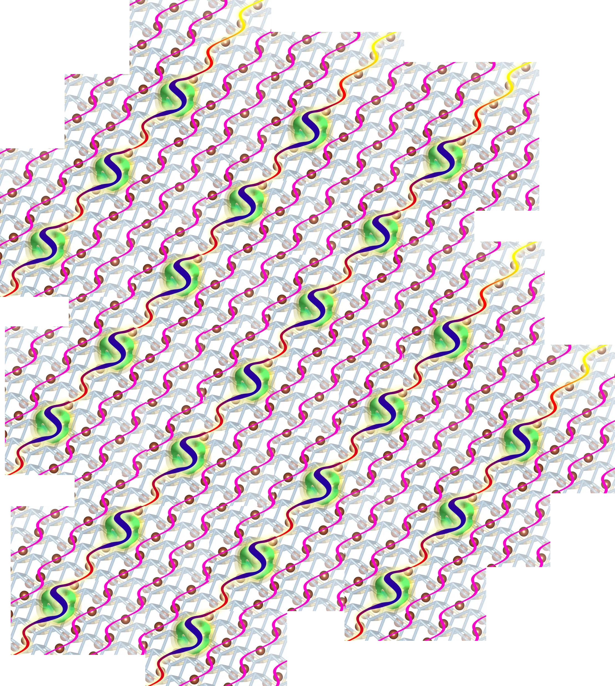
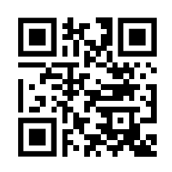


1st Magnetoelastic Workshop September 18-19, 2023 Charles University, Prague, Czechia melw23.eu
Aim
Schedule
Magnetoelastic Workshop is dedicated to discuss problems of phonon electron coupling and in general breaking of the Born-Oppenheimer approximation.
Invited speakers will present their findings from the theoretical and experimental studies of the topic.
The goal is to gather the community and establish a ground for scientific exchange and collaboration.
18-19 September 2023
Lunch to lunch
Detailed program will be announced and updated on the workshop webpage
Location
Charles University
V Holešovičkách 2, CZ-18000 Praha 8, Czechia
Further details
Up-to-date information available on
melw23.eu
Organizers and contact
Petr Cermak petr.cermak@matfyz.cuni.cz
Michal Stekiel m.stekiel@fz-juelich.de
Astrid Schneidewind

Slide 2
1st Magnetoelastic Workshop September 18-19, 2023 Charles University, Prague, Czechia melw23.eu
Aim
Schedule
Magnetoelastic Workshop is dedicated to discuss problems of phonon electron coupling and in general breaking of the Born-Oppenheimer approximation.
Invited speakers will present their findings from the theoretical and experimental studies of the topic.
The goal is to gather the community and establish a ground for scientific exchange and collaboration.
18-19 September 2023
Lunch to lunch
Detailed program will be announced and updated on the workshop webpage
Location
Charles University
V Holešovičkách 2, CZ-18000 Praha 8, Czechia
Further details
Up-to-date information available on
melw23.eu
Organizers and contact
Petr Cermak petr.cermak@matfyz.cuni.cz
Michal Stekiel m.stekiel@fz-juelich.de
Astrid Schneidewind

Slide 3
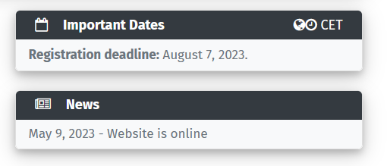
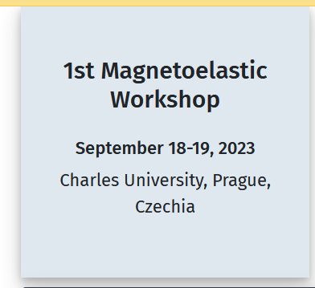
Color probes

Slide 5
